Slide 1
Welcome to Tanfel!
Manufacturing Capabilities
Services
The Tanfel Advantage

Slide 2
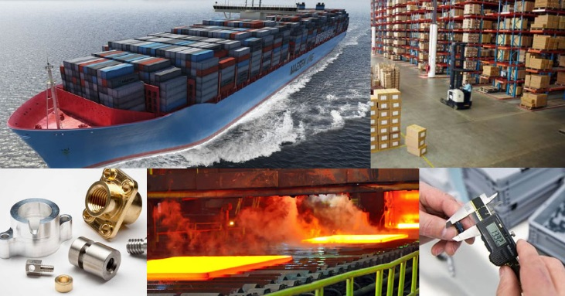
About Us
Tanfel is a complete custom parts supply chain solution including Stocking, Warehousing, Delivery and Distribution programs for custom fabricated parts.
Custom fabricated products are needed in most manufactured products ranging from staplers, to medical equipment to cell phones. Our products are used by manufacturers worldwide in almost every industry: Electronics, Government/Military, Aerospace, Medical, Utilities, Construction, Automotive, Lighting, Oil and Gas, Health and Fitness and Communication to name a few.
Tanfel aims to provide customers with a one stop solution for their custom fabrication product needs.

Slide 3
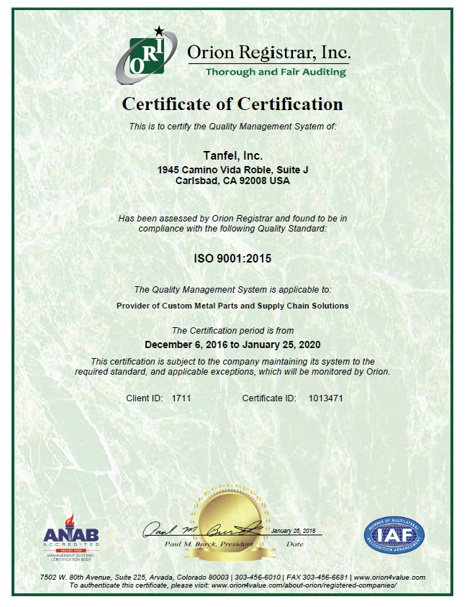
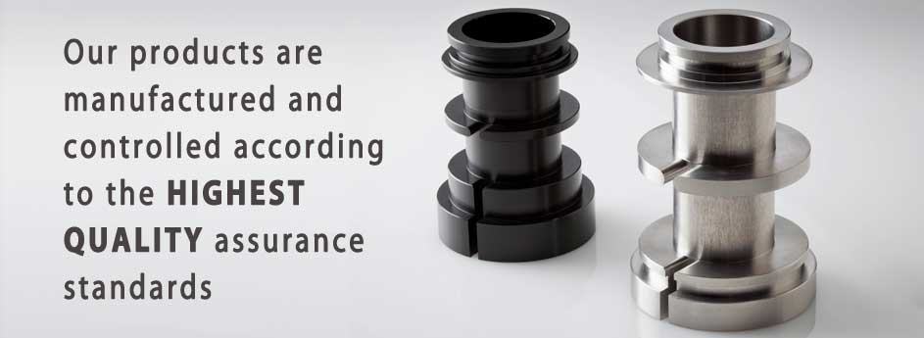
Quality Policy
Tanfel strives to provide the best product and value to its customers. Quality and on-time delivery is supported by integrity and outstanding service. We will maintain an effective Quality Management System in order to meet and exceed our customers’ requirements. We believe in employees’ involvement, continual improvement, and proactive teamwork with our partners.
Tanfel is ISO 9001:2015 certified

Slide 4
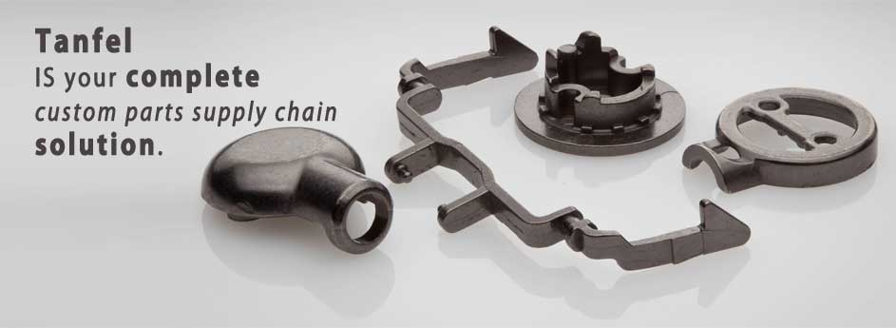
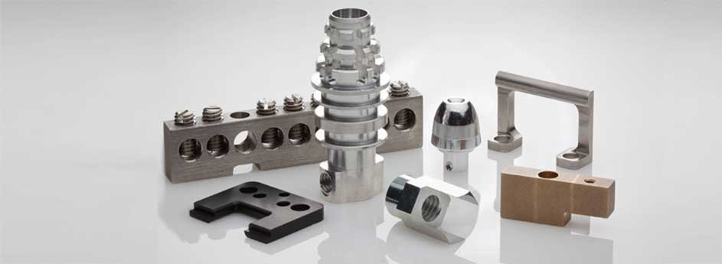
Our strong supply chain solutions include:
Stocking, Warehousing, Delivery & Distribution Programs to fit your needs.
Tanfel parts are used by many leading companies in a number of industries including:
Medical, Government / Military, Automotive, Lighting, Health & Fitness, Communication, Consumer Electronics, Instrumentation & many more.
We are confident that we can deliver your parts efficiently from your innovative design to a delivered end-product at your dock.
Mission Statement
Superior service at every stage for our customers
Values
Our combination of world class manufacturing, engineering support, warehouse and logistics services and project
management,
work with you
from prototype
to large production.
Make the best product. Provide a good value to our customers.
Maintain the highest standards and integrity.

Slide 5
Tanfel Capabilities Include

Slide 6
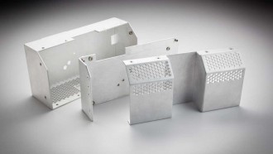
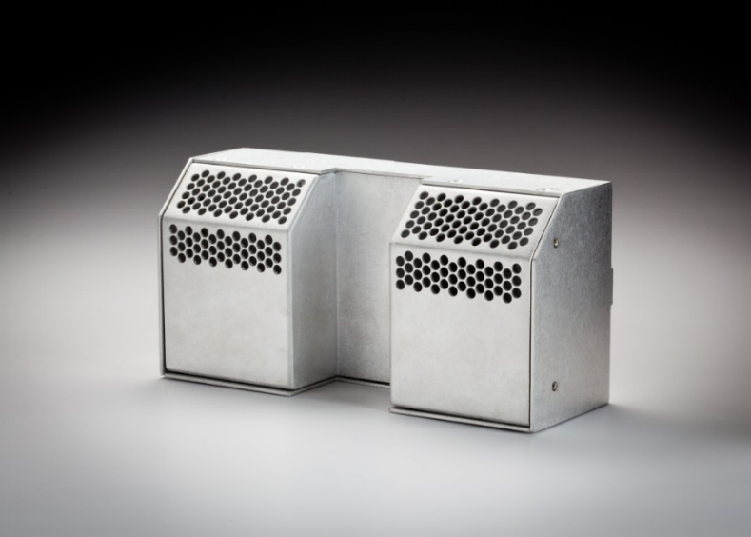
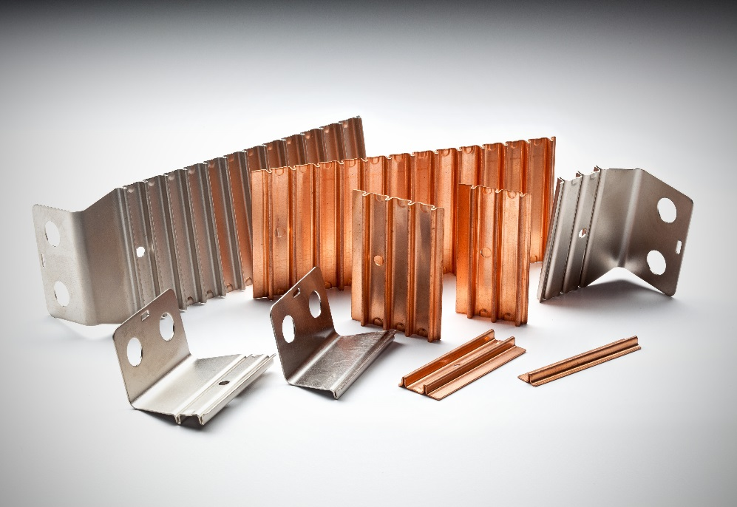
Stamping
Materials: Aluminum, Copper, Zinc, Nickel / Nickel alloy, Steel
Progressive die, single die, deep draw, turret punch, bending, laser cutting
Secondary Operations: Drilling / Tapping, CNC Machining, Grinding, EDM cutting ,Heat treating / Stress relieving, Welding, Anodizing, Electroplating
Finish: Anodizing, electroplating, powder coating, silkscreen and pad printing
In house tool making
Max tool size capable: 3500mm(L) X 1000mm(W)
Category | Tolerance
Blanking & Piercing | +/- 0.01mm
Forming | +/- 0.05mm
Deep Draw | +/- 0.05mm
Surface Roughness | Ra 0.8
Straightness (CNC) | 0.02mm
Tooling Manufacturing | +/- 0.005mm
Flatness | 0.05mm

Slide 7
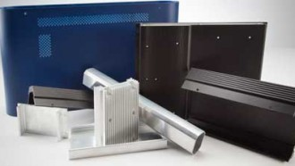
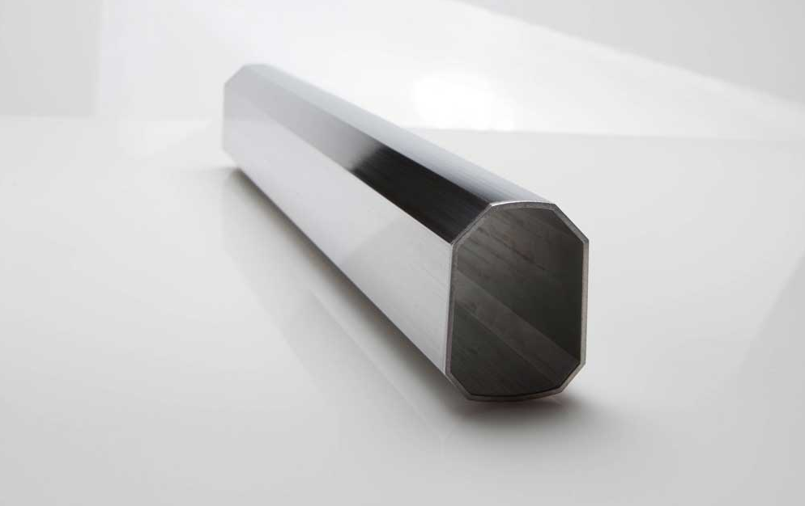
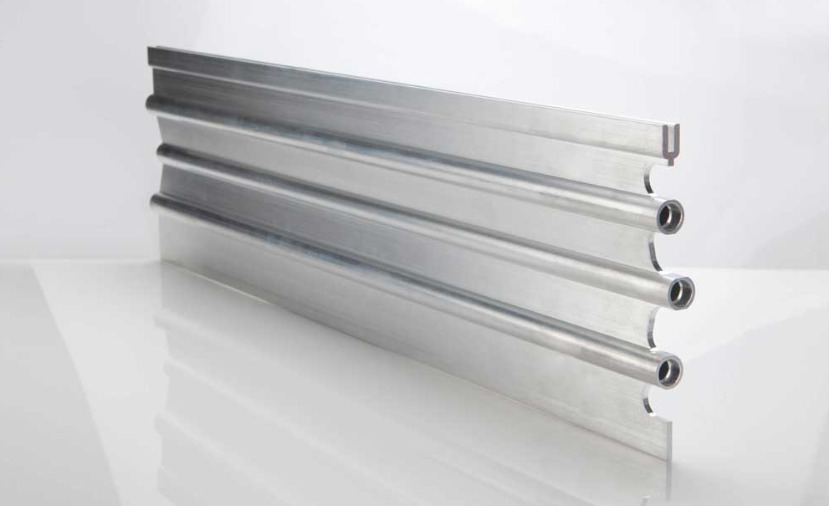
Extrusion
Aluminum ( 1xxx, 2xxx , 3xxx , 5xxx , 6xxx , 7xxx ) series
Circle / Diameter : 12mm – 430 mm
Secondary operations: Machining, Grinding, EDM cutting, Heat treating / Stress relieving, Welding,
Finish: Anodizing, Electroplating, Painting, Powder coating, Printing / Labeling

Slide 8
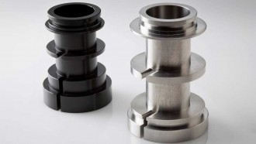
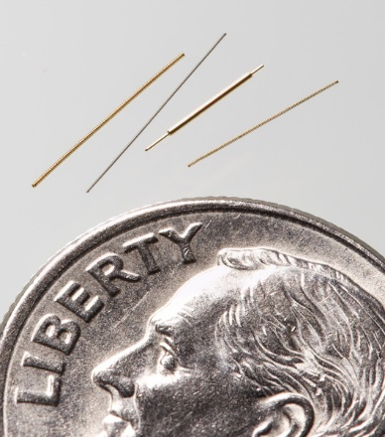
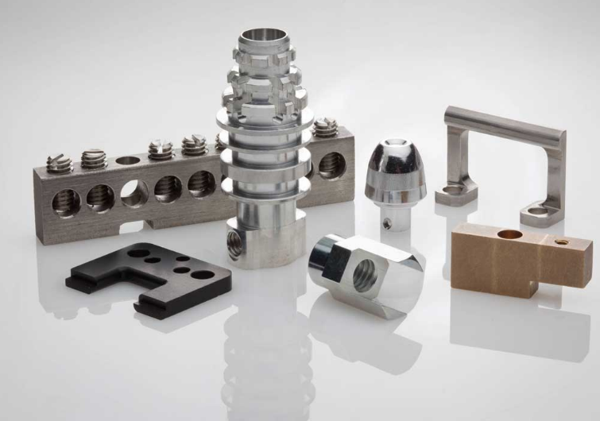
CNC - Machining
Materials: Aluminum, Brass, Bronze, Cast Iron, Copper, Hardened metals, Nickel / nickel alloys, Stainless steel
2 axis – 5 axis machining
Specialty machining: Rotary transfer machine, Jig / Fixture manufacturing, Casting machining, Tool & die manufacturing
Capabilities: Drilling, Milling, Turning, Jig boring, Electrode & Wire EDM, Broaching, Honing, Laser machining, Screw machining
CNC – Lathe/Turning
Materials: Aluminum, Steel, Brass, Bronze, Iron and more
Diameter: 1mm – 635 mm
Tolerance: +/- 0.002 mm
Length: 3050 mm

Slide 9
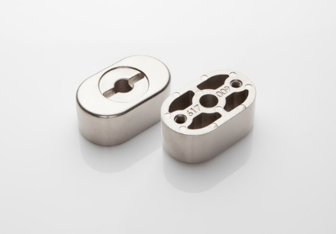
Die Casting
Below are few basic guidelines for Aluminum, Zinc and Magnesium alloys.
Aluminum Alloys:
• Relatively lightweight (270% lighter then zinc)
• High resistance to corrosion
• Good mechanical properties
• Good dimensional stability
A380:
This alloy is the most used because it offers the best combination of properties and ease of production.
A360:
Higher resistance to corrosion, better strength at higher temperatures and relatively more ductile, however this alloy is more difficult to cast.
Zinc Alloys:
• Considered as the easiest to cast.
• Longer tool life due to lower temperatures and pressures
• Ability to be produced in thin wall thicknesses and tighter tolerances
• Good for plating and coating
Magnesium Alloys:
• Lightest weight among commonly used structural metal (50%) lighter then aluminum
• High strength to weight ratio
• Excellent damping ability
• EMI shielding ability
Material: Aluminum Magnesium and Zinc
Press Size: 12 ton to 1250 ton
Secondary Operations: CNC, Drilling / Tapping, sanding , polishing, trim press, shot blasting and more
Finish: Chrome free passivation, Teflon coating, ceramic coating, polishing, wet paint, powder coat, silkscreen, pad printing

Slide 10
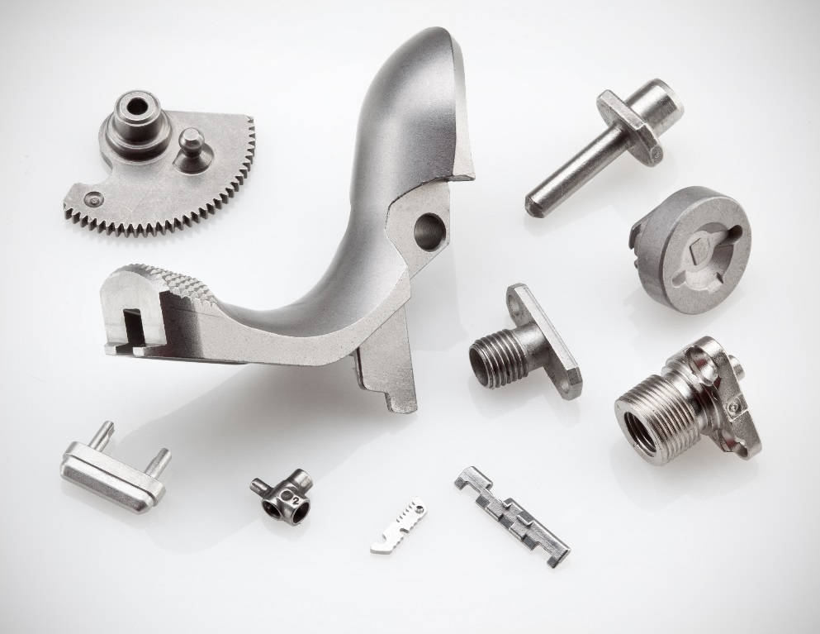
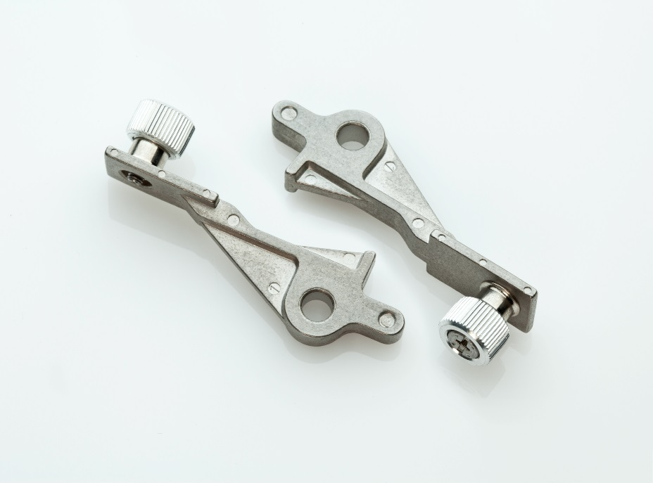
MIM – Metal Injection Molding
Materials: Stainless Steel , Nickel Steel, Tool steel, Titanium, Tungsten Carbide, and more
Up to 100 mm diameter
Material: Case hardened steel: MIM8620, 9310, 4600 Through hardened steel: MIM 4650, 4340, 4140, 52100 Stainless steel: SS17-4ph, 304L, 420 High Temp. App: 440C, 310Nb, 310 Corrosion Resistant: SS316L, 310Nb Magnetic material: Fe3Si, SS430, Fe-49Co-2V Heavy / Super Alloy: WHA1, WHA2, Inconel, Nimonic90 Tool steel: S7, M2, D2
Weight limit: Ideal is 0.1 – 50 gm
Length limit: 200 mm Ideal is < 60mm
Wall thickness: 0.5mm – 5mm
Tolerances per ISO 2768 (m) Rule of thumb is +/- 0.5% of nominal dimension

Slide 11
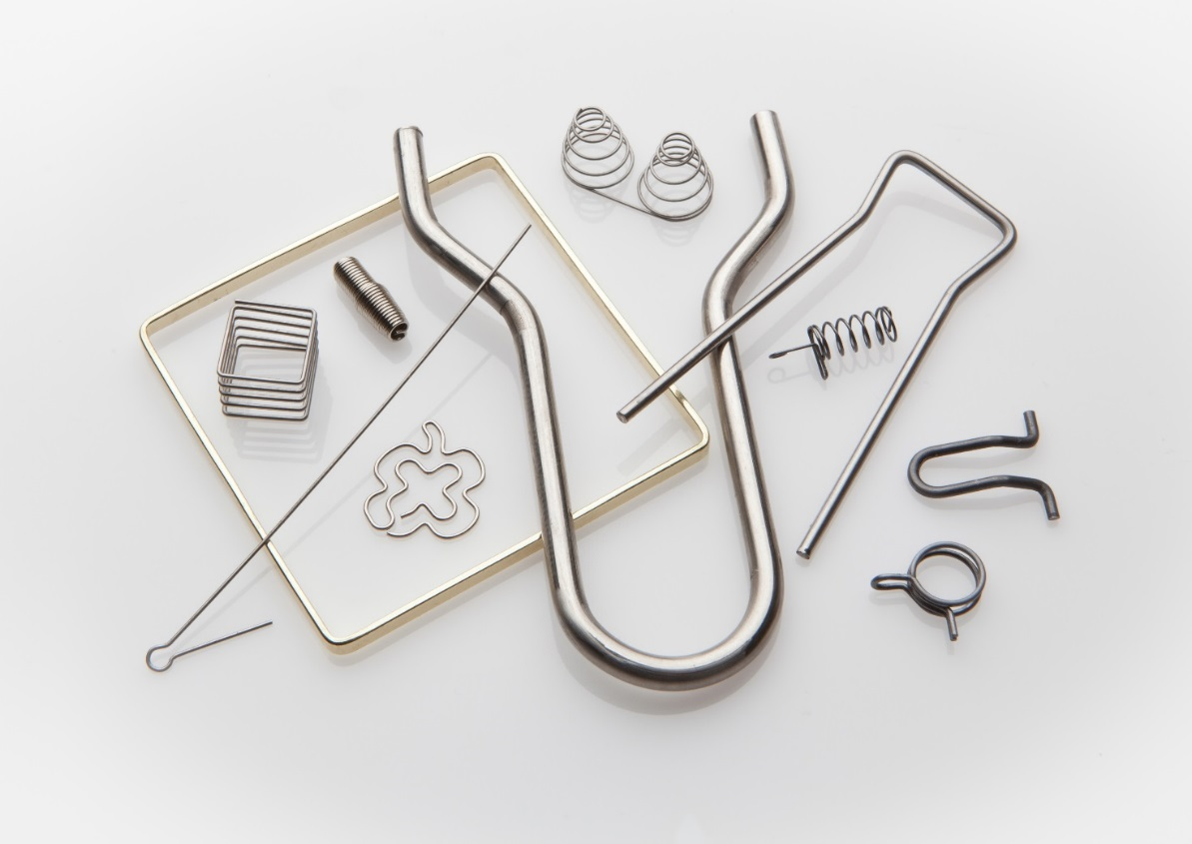
Wire Forming/Springs
A few things to know about wire forming and springs
Useful in open configurations such as those used in baskets and fan or machine guards
Wire can provide an economical configuration, sometimes with a spring effect incorporated and sometimes as a rigid member
Bending methods used for sheet metal, rod, tube, and other cross-sections are common wire formed applications
Other operations that can be performed on wire include swaging, cold heading, resistance, arc or gas welding and threading
Wire can be bent with hand-powered bending brakes, kick presses, press breaks, four-slide machines, and other equipment
Materials: SUS 304 , SUS 316 , Copper and Brass wire
Diameter: 0.05mm – 4.0mm
Shapes: Flat, Round, Oval and custom shapes

Slide 12
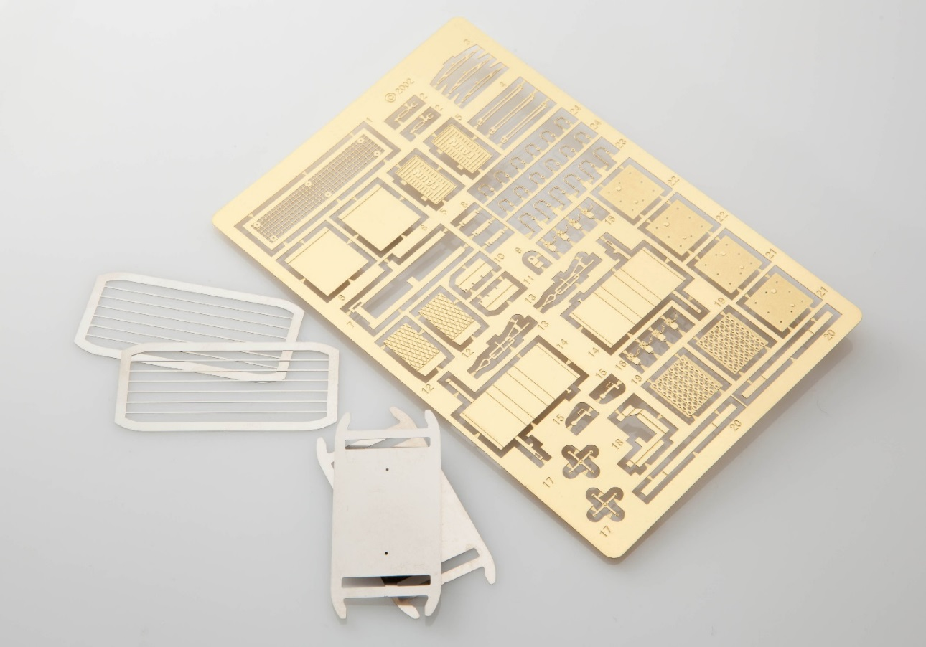
Photo/Chemical Etching
Offers economical alternatives to stamping, punching, laser or water jet cutting, or wire electrical discharge machining (EDM) for thing gauge precision parts
Inexpensive tooling and generally fast-paced production
Useful for prototyping and allows for easy changes in mass production
Industrial applications can include fine screens and meshes, apertures and masks, battery grids, fuel cell components, sensors, springs, pressure membranes, heat sinks, flexible heating elements, metal gaskets and seals, shields and retainers, and so on.
Stainless Steel , Copper , Brass, Aluminum, Silicon Carbide
Material thickness: .05 – 1.00 mm
Maximum size: 300mm x 600 mm
Pressing plus etching available

Slide 13
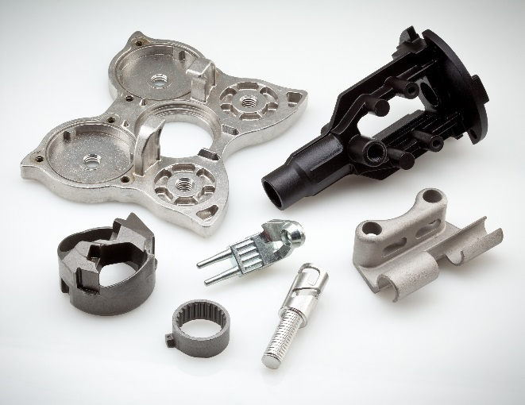
Investment Casting
Wall Thickness Tolerance – 0.01 ~ 0.015 (0.25mm ~ 0.375mm)
Angularity – 0.5° ~ 1°
Perpendicularity – 0. 008 / 1 (0.08mm / 10mm)
Surface Texture 125 RMS Max 115 AA Max 60 Wheelcraft Max
Dimension of Size Max. Size 400 * 300 * 200mm Min. Thickness 0.3mm Weight 5g ~ 35kg
The most common alloys are listed below. Other alloys are available upon request. Specific material chemistry and mechanical specifications will be available upon request.
Carbon Steel
Low Alloy Steel
300 Series Stainless Steel
400 Series Stainless Steel
Precipitation Hardened Stainless Steel
Tool Steel
Nickel Base Alloy
Cobalt Base Alloy
Aluminum Alloy
Material: Carbon steel, Low alloy steel, Stainless steel, Nickel and Cobalt alloys, Heat resistant alloys, Silicon Carbide
20 grams – 10 kg
Maximum size: 300mm x 600mm
Up to 400mm long. 2mm – 50mm wall thickness.
Sand Casting
Materials: Iron, Steel, Bronze, Brass, Aluminum, Magnesium, Zinc (alloys)
Processes include: Green Sand and No Bake

Slide 14
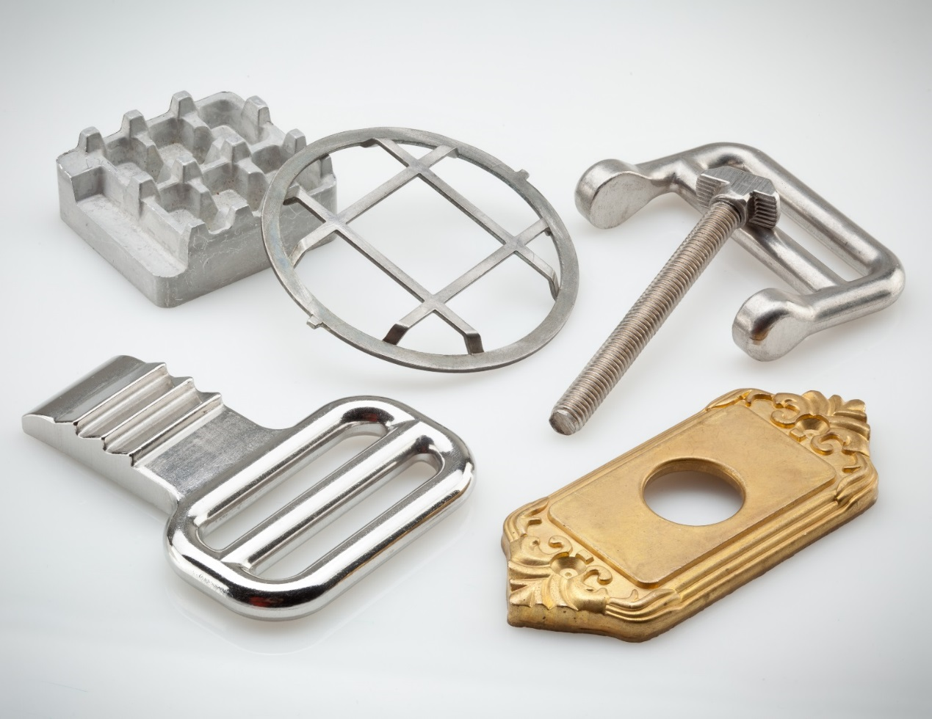
Forging
A few things to know about forging
Can produce a piece that is stronger than an equivalent cast or machined part
Forgings can target a lower total cost when compared to a casting or fabrication
Material: Aluminum, Brass, Stainless steel, Titanium Grade 2
Hot forging. 300 and 400 ton presses

Slide 15
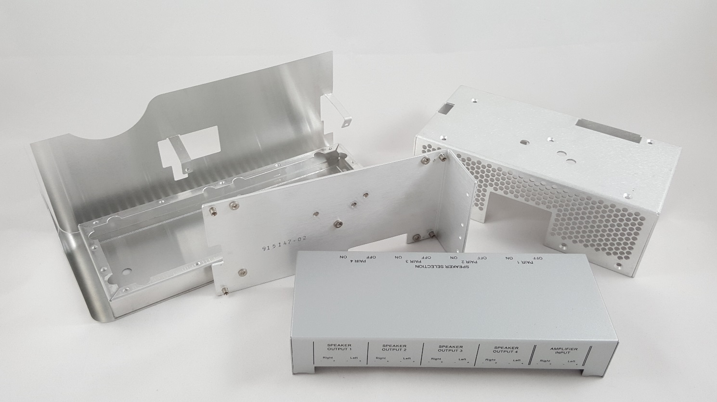
Sheet Metal
Sheet metal is metal formed by an industrial process into thin, flat pieces
Can be cut into a variety of shapes
Thickness can vary significantly
Available in flat pieces or coiled strips
Materials: Aluminum, Brass, Copper, Steel, Tin, Nickel, Titanium
Available in flat pieces or coiled strips
Forming processes include: bending, curling, decambering, deep drawing, expanding, hydroforming, laser cutting, rolling, stamping, and more

Slide 16
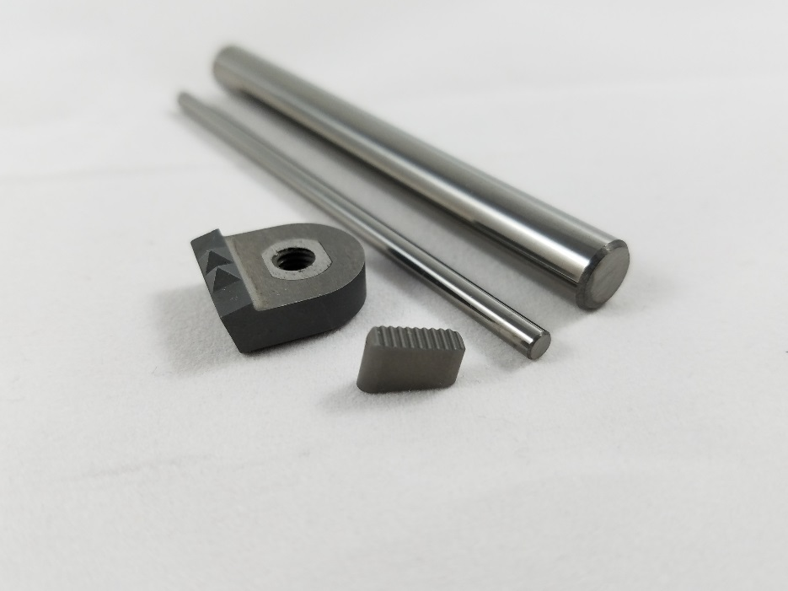
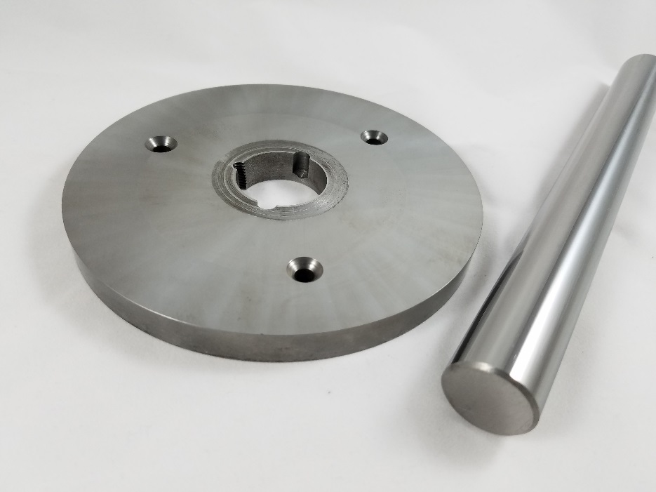
Cemented Carbide
Consists of fine particles of carbide cemented into a composite by a binder metal
Typically used in cutting tools for machining as well as other industrial applications
Material: Carbide , Tungsten, Molybdenum, Tantalum, Niobium
Rods, Bars, Strips and Custom parts

Slide 17
Tanfel Services
Improve Your Supply Chain While Saving Money
Tanfel strives to be your partner of choice for your custom fabricated products.
We work with you in all stages of your project. We provide design and prototype support through large production and vendor managed inventory programs. We will do this seamlessly so you can spend your valuable time on your innovative product.
You can be assured that your supply chain is the best in the world while saving money
The Process
Design Support
Prototype Manufacturing
Consistent & Clear Communication
Production Manufacturing
Quality Control
Worldwide Logistics
U.S. Warehousing
Customer Delivery & Support

Slide 18
Design Support
We will work with your engineers to ensure that we fully understand your design and needs. We can provide design suggestions and alternatives to improve functionality and or reduce cost.
Prototype Manufacturing
Prototypes can be made to proof design. This can be done quickly and with little or no tooling costs. Primary manufacturing methods are CNC and EDM, but other methods are available.
Consistent & Clear Communication
We understand that this is a key factor in you meeting your goals and deadlines. Your account manager will be available to answer any questions you may have. Our online resources are also available 24/7.
Production Manufacturing
Tanfel partners with only the best ISO certified facilities throughout the world. All facilities are certified and regularly measured and audited to ensure the best results for our customers.
Quality Control
Quality and service are our passion. Our products and facilities are consistently monitored to ensure that you always receive the highest quality products possible. All facilities are ISO certified at a minimum.
Worldwide Logistics
Deliver to any worldwide location. Your quoted price is to your dock pricing. You do not have to worry about shipping, tariffs, bonds, inspection fees, fuel surcharges or any other unexpected costs.
U.S. Warehousing
Vendor Managed Inventory ( VMI), Kan Ban and other customized programs are available to meet your needs.
Customer Delivery
Parts delivered to your dock. U.S. dollars and terms.

Slide 19
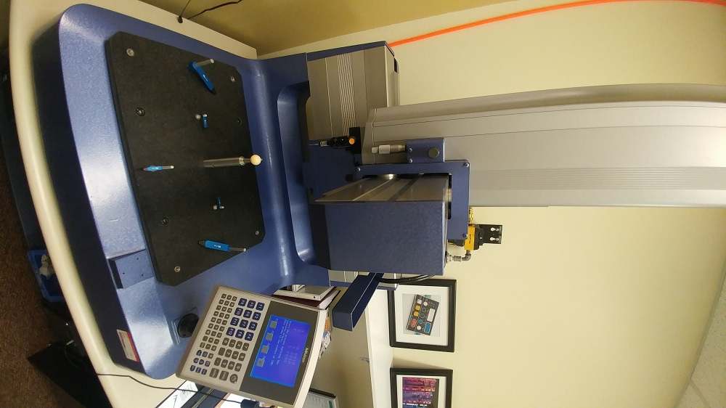
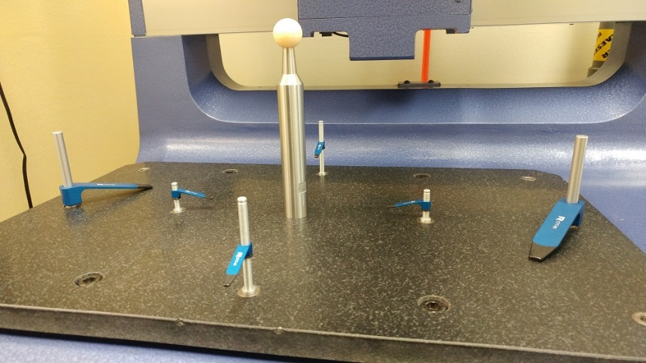
Quality Control Equipment
A coordinate measuring machine (CMM) is a device used in the measurement of the physical geometrical characteristics of an object. Measurements are defined by a probe attached to the 3rd moving axis of this manual machine. By precisely recording the X, Y, & Z coordinates of the object, points are generated which can then be analyzed via regression algorithms for the construction of features. These points are then collected by using a probe that is positioned manually by an operator.
Manual Coordinate Measuring Machine
(CMM)
CMM Clamps & Fixtures

Slide 20
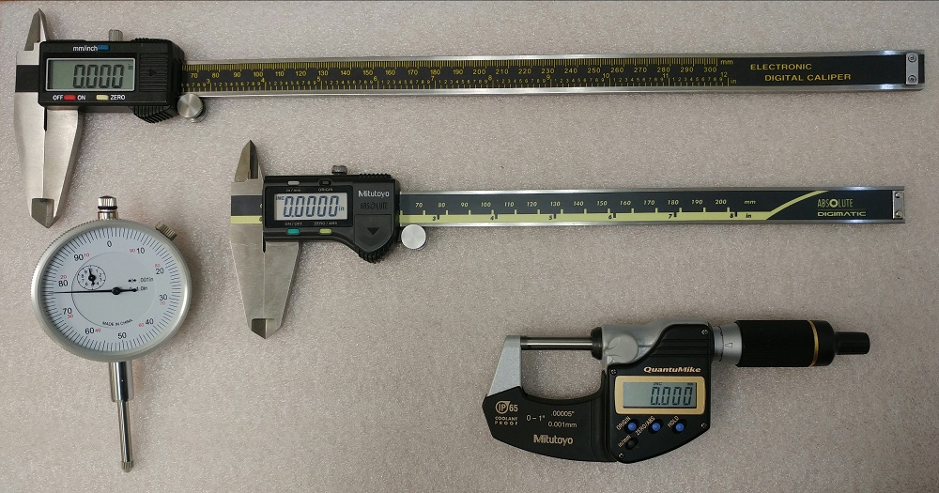
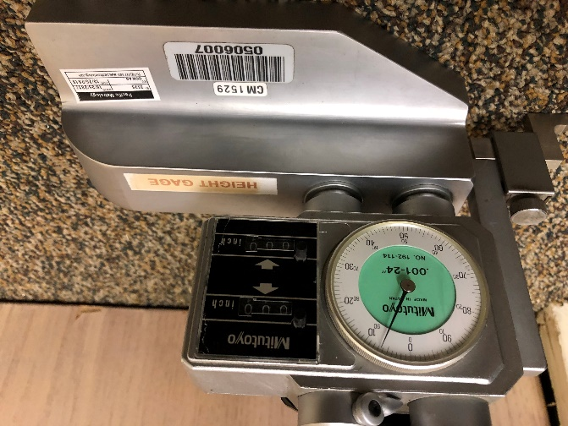
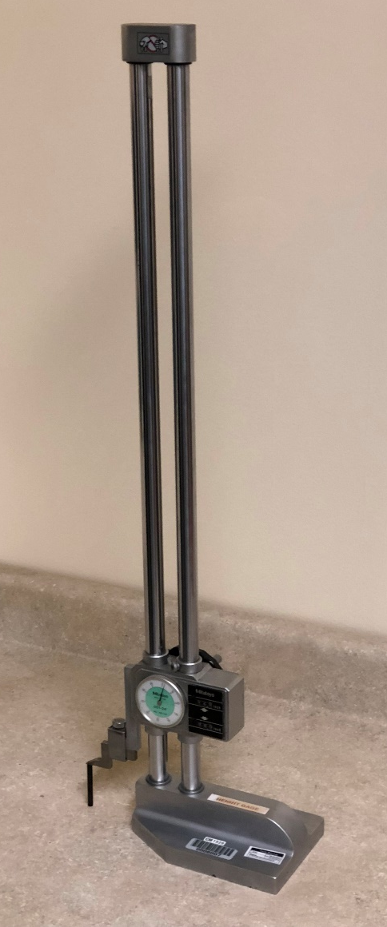
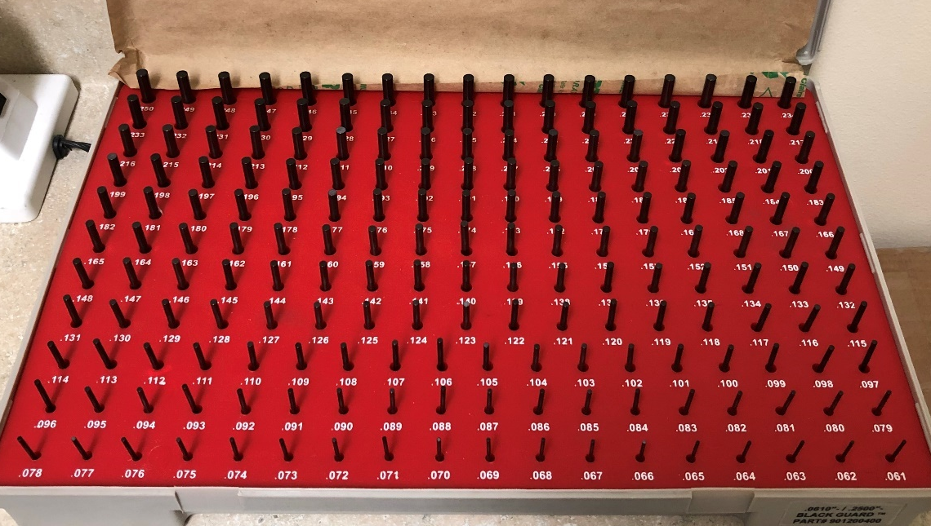
Quality Control Equipment
Calipers & Micrometers
Absolute Digital Calipers, 0-12” & 0-8” range, +/-0.0015” accuracy, in/mm
Outside Micrometer, No output, 0-1” x .00005”/0.001mm
Height Gage
.011-24” range, 192-114 series, 0.0015 in accuracy
Calipers are devices used to measure the distance between two opposite sides of an object, whereas pin gages are used to make quick and accurate measurements of hole sizes.
Pin Gage Set
Min ⌀ 0.061 - Max ⌀ 0.250, Class ZZ

Slide 21
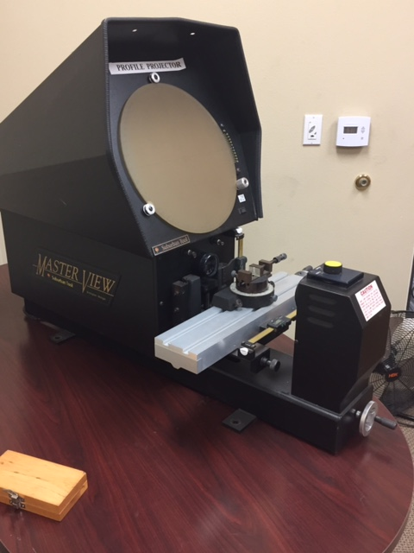
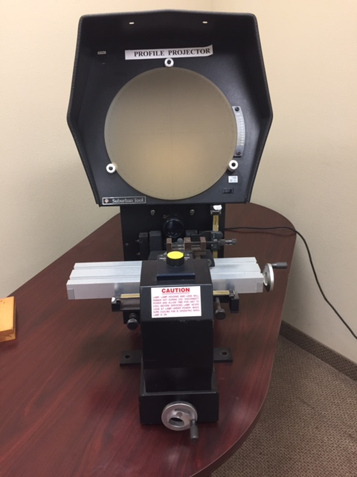
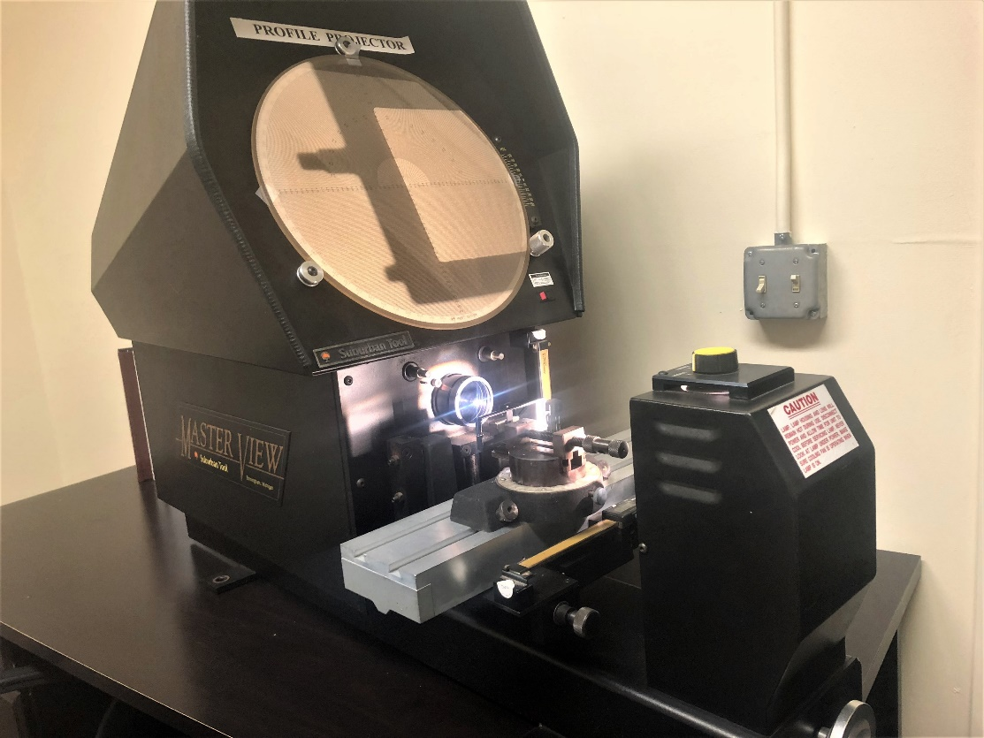
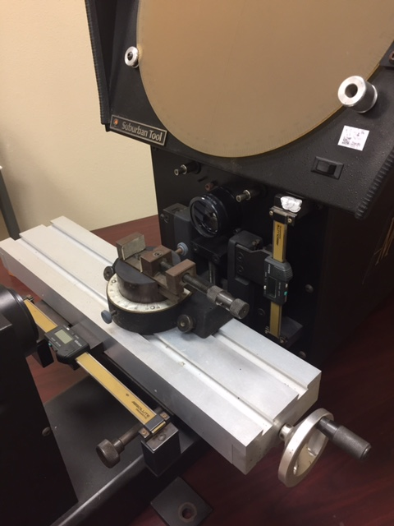
Quality Control Equipment
Profile Projector
Also known as an optical comparator, a profile projector is an optical instrument that can be used for measuring. It is widely used for complex shape stampings, gears, cams, threads, and comparing the measured contour model.
The projector magnifies the profile of the specimen, and displays this on the built-in projection screen. On this screen there is a grid that be rotated 306 degrees so the X-Y axis of the screen can be aligned with a straight edge of the machined part to examine or measure. This projection screen displays the profile of the specimen and is magnified for better ease of calculating linear measurements.

Slide 22
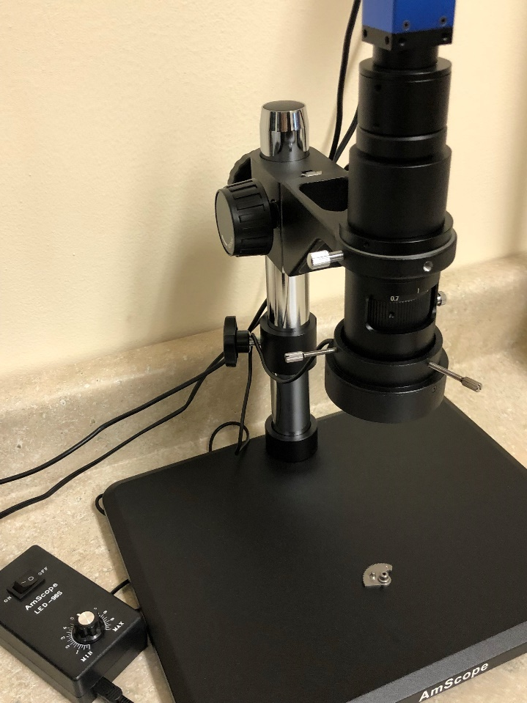
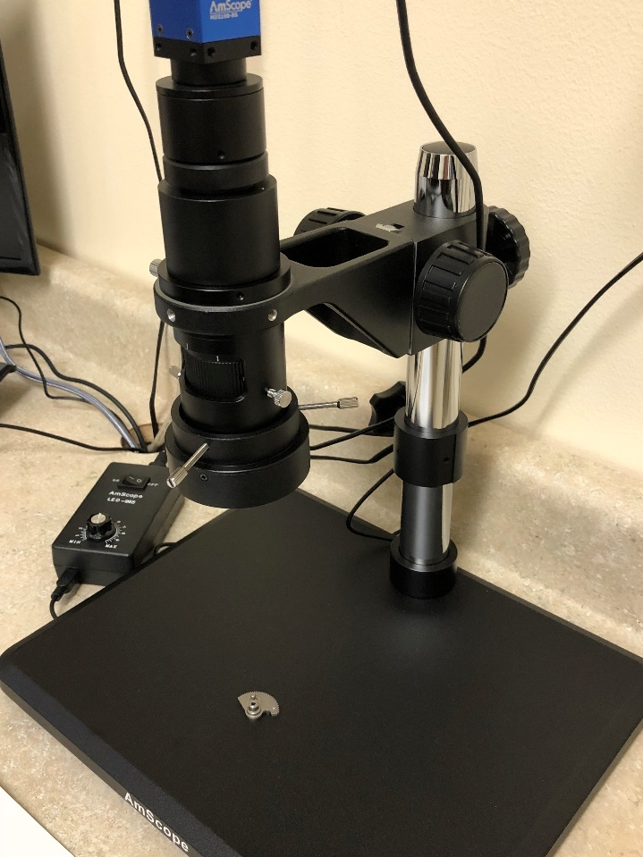
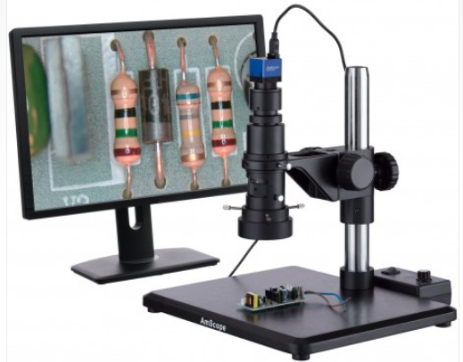
Quality Control Equipment
Monocular Microscope
High-Speed Industrial Inspection Zoom Monocular Microscope System
0.7x – 5.0x zoom objective
C-mount lens
High-speed 3.1MP USB 2.0 camera
Frame-rates up to 83fps
Working distance: 4-1/8” (105mm)
Field of view: ½” x 11/16” (12.9mm x 17.1mm) to 5/64” x 3/32” (1.8mm x 2.4mm)

Slide 23
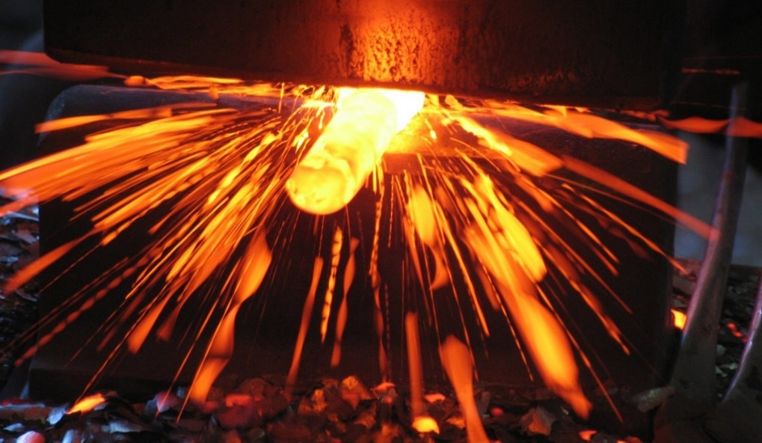
The Tanfel Advantage
Cost Reduction Initiatives
Quality Control
Vendor Auditing
Domestic Stocking/Warehousing
Logistics Management
U.S. Customer Service
Global Pricing Options
Strong Design and Engineering Support
Single Source Accountability
Contact Us
email
support@tanfel.com
phone
(760) 720-9632
address
1945 Camino Vida Roble
Suite J
Carlsbad, CA 92008

